Slide 1
Principles of Scalable Performance
CSD208 – Computer Architecture

Slide 2
Parallelism profile in programs
The execution of a program on a parallel computer may use different number of parallel processors at different time periods during the execution cycle.
For, each time period, the number of processors used to execute a program is defined as the degree of parallelism (DOP).
It is a discrete time function, assuming only non-negative integer values.
The plot of DOP as a function of time is the Parallelism profile of the program.
Fluctuation in the profile occurs due to algorithmic structure, program optimization, resource utilization, and runtime conditions of the computer system.

Slide 3
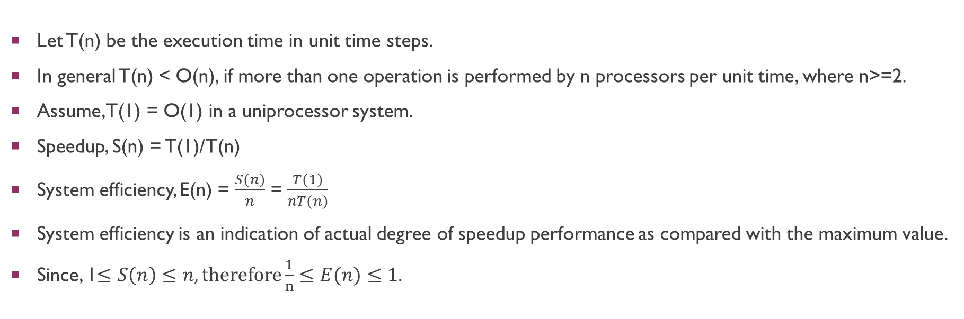
System Efficiency
Let T(n) be the execution time in unit time steps.
In general T(n) < O(n), if more than one operation is performed by n processors per unit time, where n>=2.
Assume, T(1) = O(1) in a uniprocessor system.
Speedup, S(n) = T(1)/T(n)
System efficiency, E(n) = $\frac{S(n)}{n}$ = $\frac{T(1)}{nT(n)}$
System efficiency is an indication of actual degree of speedup performance as compared with the maximum value.
Since, 1$≤S\left(n\right)≤n, therefore\frac{1}{n}≤E(n)≤1.$

Slide 4
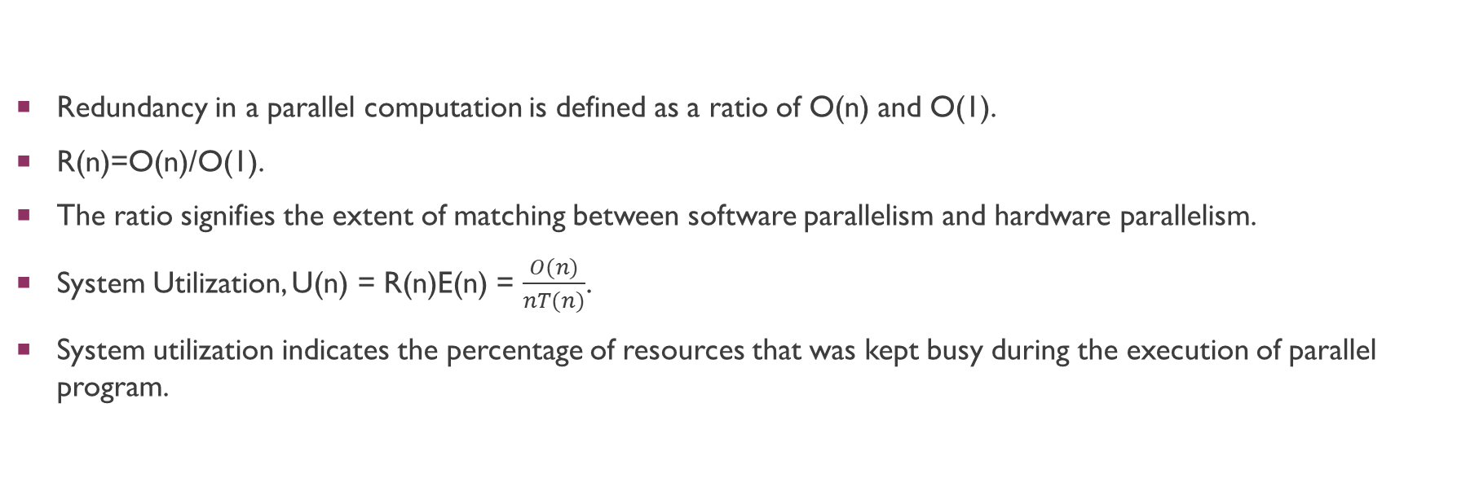
Redundancy
Redundancy in a parallel computation is defined as a ratio of O(n) and O(1).
R(n)=O(n)/O(1).
The ratio signifies the extent of matching between software parallelism and hardware parallelism.
System Utilization, U(n) = R(n)E(n) = $\frac{O(n)}{nT(n)}$.
System utilization indicates the percentage of resources that was kept busy during the execution of parallel program.

Slide 5
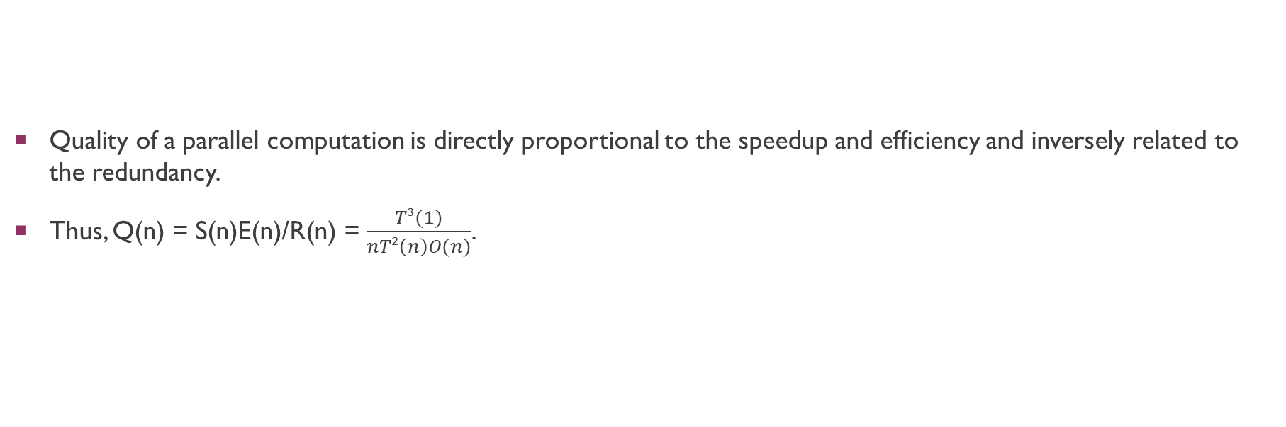
Quality of parallelism
Quality of a parallel computation is directly proportional to the speedup and efficiency and inversely related to the redundancy.
Thus, Q(n) = S(n)E(n)/R(n) = $\frac{T3(1)}{nT2\left(n\right)O(n)}$.

Slide 6

Example:
O(1) = T(1) = n³
O(n) = n³ + n²logn
T(n) = $\frac{4n3}{n+3}$
S(n) =
E(n) =
R(n) =
U(n) =
Q(n) =

Slide 7
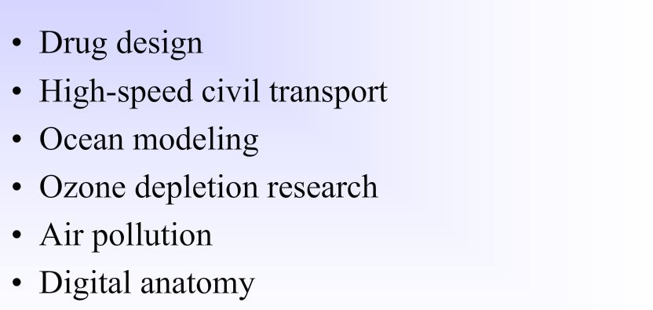
Massive parallelism for grand challenges

Slide 8
Algorithmic characteristics
Computational algorithms are traditionally executed sequentially on uniprocessors. Parallel algorithms are those specially devised for parallel computers.
The idealized parallel algorithms are those written for the PRAM models if no physical constraints or communication overheads are imposed.
In the real world, an algorithm is considered efficient only if it can be cost effectively implemented on physical machines. In this sense, all machine-implementable algorithms must be architecture-dependent.
This means the effects of communication overhead and architectural constraints cannot be ignored.

Slide 9
We summarize below important characteristics of parallel algorithms which axe machine implementable:
Deterministic versus nondeterministic: Only deterministic algorithms are implementable on real machines. Our study is confined to deterministic algorithms with polynomial time complexity.
Computational granularity: Granularity decides the size of data items and program modules used in computation. In this sense. we also classify algorithms as fine-grain, medium-grain, or coarse-grain.
Parallelism profile: The distribution of the degree of parallelism in an algorithm reveals the opportunity for parallel processing. This often affects the effectiveness of the parallel algorithms.
Communication patterns and synchronization requirements: Communication patterns address both memory access and inter-processor communications. The patterns can be static or dynamic, depending on the algorithms. Static algorithms are more suitable for SIMD or pipelined machines, while dynamic algorithms are for MIMD machines. The synchronization frequency often affects the efficiency of an algorithm.
Uniformity of the operations: This refers to the types of fundamental operations to be performed. Obviously, if the operations are uniform across the data set, the SIMD processing or pipelining may be more desirable. In other words, randomly structured algorithms are more suitable for MIMD processing. Other related issues include data types and precision desired.
Memory requirement and data structures: In solving large-scale problems, the data sets may require huge memory space. Memory efficiency is affected by data structures chosen and data movement patterns in the algorithms. Both time and space complexities are key measures of the granularity of a parallel algorithm.

Slide 10
isoefficiency
The workload w of an algorithm often grows in the order 0(s), where s is the problem size. Thus, we denote the workload to w(s) as a function of s.
The isoefficiency concept relating workload to machine size n needed to maintain a fixed efficiency E when implementing a parallel algorithm on a parallel computer.
Let k be the total communication overhead involved in the algorithm implementation. This overhead is usually a function of both machine size and problem size, thus denoted k = h(s,n). The efficiency of a parallel algorithm implemented on a given parallel computer is thus defined as: E(s) = w(s)/(w(s) + h(s,n)).
The workload w(s) corresponds to useful computations while the overhead h(s,n) are useless computations attributed to synchronization and data communications delays. In general, the overhead increases with respect to both increasing values of a and n. Thus, the efficiency is always less than 1. The question is hinged on relative growth rates between w(s) and h(s,n).

Slide 11
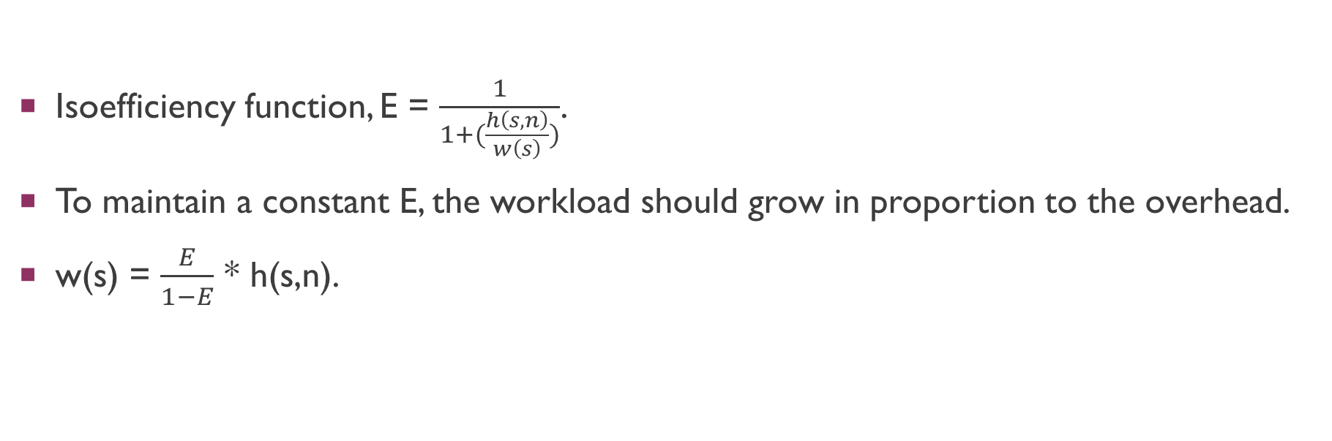
Isoefficiency function
Isoefficiency function, E = $\frac{1}{1+(\frac{h\left(s,n\right)}{w\left(s\right)})}$.
To maintain a constant E, the workload should grow in proportion to the overhead.
w(s) = $\frac{E}{1−E}$ * h(s,n).

Slide 12
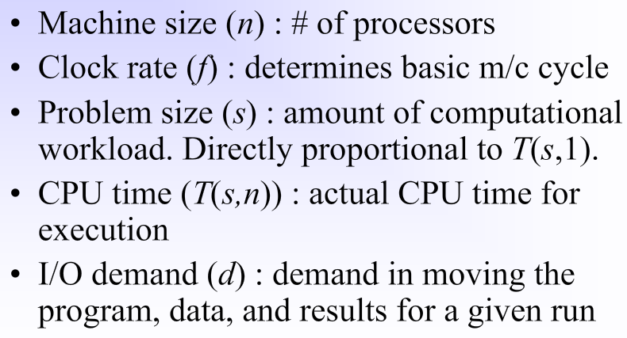
Scalability metrics

Slide 13
